Slide 1



Co-existence of legacy and P4-offloaded 5G UPF deployments using open-source software
Apostolos Prassas
Georgios P. Katsikas
Kostis Trantzas
Christos Tranoris

Slide 2
Importance of UPF
User plane function (UPF) is the data plane anchor of 5G
Separates control and user planes
Allows (high-performance) data forwarding
Acts as a policy enforcement point
Provides support for network slicing
Allows local 5G traffic breakout (MEC, low latency)
Provides implementation flexibility and programmability

Slide 3
The problem
Legacy UPFs are deployed on general-purpose CPUs
Struggle to meet high-performance standards (uRLLC, eMBB)

Slide 4
The need
To offload traffic from demanding slices into hardware
...without losing the flexibility of software-based deployments

Slide 5
Objectives

Slide 6
Objectives
1
Offload the UPF dataplane into the network
Exploit high performance network equipment
Provide a fast equivalent to legacy kernel-based UPFs
2
Design a closed-loop service to automate UPF offloading
Monitor events coming from 5GC (e.g., slice requests)
Act by instructing TFS to deploy P4-accelerated UPFs
3
Ensure that legacy and offloaded UPFs can co-exist
Integrate both with an end-to-end open-source 5G (OAI)

Slide 7
Challenges

Slide 8

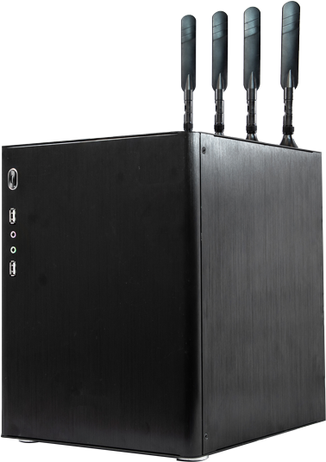

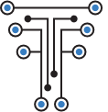

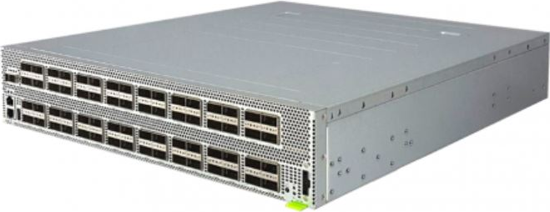


Challenges
1
Hide the complexity of a P4-based UPF from the end user
High-level Service intent
2
Pick the right tools to allow easy testing
UPF Connectivity Service
emulates
5G gNB
gnbsim
Low-level P4 instructions
bmv2
Tofino
mimic
UPF
TNA
End-to-end integration with an open 5GC (OAI)
Equivalence with real physical deployments

Slide 9
Background in 5G
And the role of UPF

Slide 10
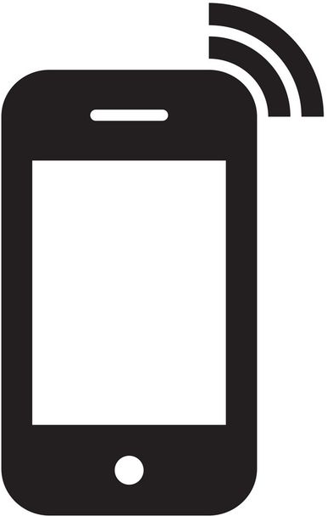


Simplified 5G architecture around UPF
5GC
PFCP
N4
UL
DL
GTP tunnel
5G UPF
Data Network
N6
N3
5G UE
UL
5G gNB
To I-UPF
DL
N9

Slide 11
Methodology

Slide 12
A Closed-loop Architecture
Open 5G
implementation
5GC
Legacy UPF
DNN 1 Internet

Slide 13
A Closed-loop Architecture
UPF
DNN 2 Intranet
Open 5G
implementation
5GC
Legacy UPF
DNN 1 Internet
Open 5G UPF implementation

Slide 14

A Closed-loop Architecture
Closed-loop design
Orchestration Platform
Specific UE slice request
action
event
Provision offloaded UPF
UPF
DNN 2 Intranet
Open 5G
implementation
5GC
Legacy UPF
DNN 1 Internet
Open 5G UPF implementation

Slide 15
Relation with ETSI

Slide 16
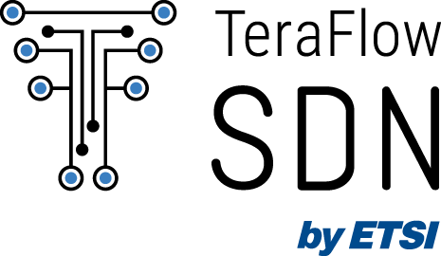
Why is this relevant for ETSI SDGs?
What is new? | Relevance with ETSI SDGs and other open-source projects and/or standards
Integration between ETSI OSL and ETSI TFS via the TFS NBI
Integration between OAI (SD-Fabric version) and Prometheus
Exploit the ETSI OSL integration with telemetry engine (OSL metrico)
New capabilities and bug fixes introduced at the TFS SBI P4 driver
1x new TFS P4 services for UPF offloading based on SD-Fabric (NEW!)
TFS integration with Stratum-based P4 switches (i.e., bmv2)
A closed-loop among all these systems (NEW!)

Slide 17
UPF Implementation
The P4 SD-Fabric dataplane

Slide 18
UPF pipeline of tables for uplink (UL)
ICMP
UPF
12.1.1.2
IPv4
10.10.2.2
GTP
Filtering
UPF Ingress
Forwarding
QoS
2152
UDP
2152
interfaces
bridging
set_slice_tc
ICMP
10.10.1.2
IPv4
10.10.1.1
default_tc
12.1.1.2
IPv4
10.10.2.2
uplink_sessions
ΕΤΗ
miss
ΕΤΗ
Pre-Next
queues
applications
next_vlan
miss
5G UE
5G gNB
miss
Egress Next
dp-1:
10.10.1.1
ingress_port_vlan
uplink_terminations
dp-2:
10.10.2.1
DNN 2
GTP
ACL
egress_vlan
fwd_classifier
uplink_recirc_rules
acl
miss
ig_tunnel_peers
miss
UE 12.1.1.2 pings 10.10.2.2
miss
Next
next (hashed)

Slide 19
UPF pipeline of tables for downlink (DL)
UPF
ICMP
10.10.2.2
IPv4
12.1.1.2
Filtering
UPF Ingress
Forwarding
QoS
GTP
ICMP
interfaces
bridging
set_slice_tc
2152
UDP
2152
10.10.2.2
IPv4
12.1.1.2
default_tc
10.10.1.1
IPv4
10.10.1.2
ΕΤΗ
downlink_sessions
miss
ΕΤΗ
Pre-Next
queues
next_vlan
miss
applications
Egress Next
5G gNB
5G UE
DNN 2
dp-2:
10.10.2.1
ingress_port_vlan
miss
dp-1:
10.10.1.1
ACL
egress_vlan
GTP
downlink_terminations
fwd_classifier
acl
UPF Egress
ig_tunnel_peers
miss
gtpu_encap
DN replies with ICMP echo reply
Next
miss
next (hashed)
eg_tunnel_peers

Slide 20
Scenario

Slide 21
Scenario

Slide 22

Scenario
Control Plane path
Data Plane path
VM #1
AMF
SD-Fabric UPF (CP)
Slice 1 Users
SMF
AUSF
DNN 1 Internet
Legacy UPF
UEs
gNB
NRF
UDM
UDR
5G Core

Slide 23





Scenario
Control Plane path
Data Plane path
Closed-loop path
VM #1
PFCP Agent
VM #4
TFS plugin
AMF
SDN Controller
Slice 1 Users
SD-Fabric UPF (CP)
P4Runtime
SMF
AUSF
SD-Fabric UPF Controller
DNN 1 Internet
Legacy UPF
UEs
gNB
NRF
P4Runtime
UDM
P4-offloaded 5G UPF
VM #2
DNN Intranet
VM #3
Slice 2 Users
UDR
5G Core
N3
N6
DNN 2
Intranet
dp-1
10.10.1.2
dp-1
10.10.1.1
dp-2
10.10.2.1
dp-1
10.10.2.2
GTP-U
UEs
gNB

Slide 24
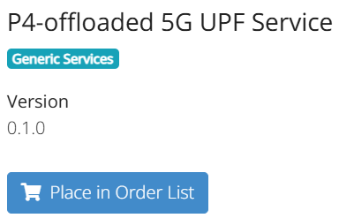

Scenario
Service Orchestrator
Control Plane path
5G Monitoring events
Actions
Data Plane path
Closed-loop path
Closed-loop Service
VM #5
VM #1
PFCP Agent
VM #4
5G Telemetry
TFS plugin
AMF
SDN Controller
Slice 1 Users
SD-Fabric UPF (CP)
P4Runtime
SMF
AUSF
SD-Fabric UPF Controller
DNN 1 Internet
Legacy UPF
UEs
gNB
NRF
P4Runtime
UDM
P4-offloaded 5G UPF
VM #2
DNN Intranet
VM #3
Slice 2 Users
UDR
5G Core
N3
N6
DNN 2
Intranet
dp-1
10.10.1.2
dp-1
10.10.1.1
dp-2
10.10.2.1
dp-1
10.10.2.2
GTP-U
UEs
gNB

Slide 25




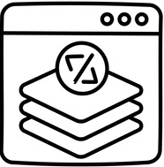


Workflow
1
Initial system state
Clean state OSL, TFS, 5GC, P4 switch, Prometheus
2
Closed-loop service design and ordering
Service design
Metrics of interest
Event trigger
3
Introduce silver-class UEs
Traffic handling through legacy UPF
4
Introduce gold-class UE
Traffic handling through legacy UPF
Event handling
Policy action

Slide 26
Initial System State
1

Slide 27
Service Orchestrator
Control Plane path
Data Plane path
Closed-loop path
Closed-loop Service
VM #5
VM #1
PFCP Agent
VM #4
TFS plugin
SDN Controller
P4Runtime
SD-Fabric UPF Controller
DNN 1 Internet
VM #2
DNN Intranet
VM #3
N3
N6
DNN 2
Intranet
dp-1
10.10.1.2
dp-1
10.10.1.1
dp-2
10.10.2.1
dp-1
10.10.2.2

Slide 28
Browse OSL Marketplace
Service Orchestrator
Control Plane path
1
Data Plane path
Closed-loop path
Closed-loop Service
VM #5
VM #1
PFCP Agent
VM #4
TFS plugin
SDN Controller
P4Runtime
SD-Fabric UPF Controller
DNN 1 Internet
VM #2
DNN Intranet
VM #3
N3
N6
DNN 2
Intranet
dp-1
10.10.1.2
dp-1
10.10.1.1
dp-2
10.10.2.1
dp-1
10.10.2.2

Slide 29
Service Orchestrator
Control Plane path
Data Plane path
Closed-loop path
Closed-loop Service
VM #5
VM #1
PFCP Agent
VM #4
TFS plugin
SDN Controller
P4Runtime
TFS clean state
2
SD-Fabric UPF Controller
DNN 1 Internet
VM #2
DNN Intranet
VM #3
N3
N6
DNN 2
Intranet
dp-1
10.10.1.2
dp-1
10.10.1.1
dp-2
10.10.2.1
dp-1
10.10.2.2

Slide 30
Service Orchestrator
Control Plane path
Data Plane path
Closed-loop path
Closed-loop Service
VM #5
VM #1
PFCP Agent
VM #4
TFS plugin
AMF
SDN Controller
SD-Fabric UPF (CP)
P4Runtime
SMF
3
AUSF
SD-Fabric UPF Controller
Deploy 5GC
DNN 1 Internet
Legacy UPF
NRF
UDM
VM #2
DNN Intranet
VM #3
UDR
5G Core
N3
N6
DNN 2
Intranet
dp-1
10.10.1.2
dp-1
10.10.1.1
dp-2
10.10.2.1
dp-1
10.10.2.2

Slide 31
Service Orchestrator
Control Plane path
Data Plane path
Closed-loop path
Closed-loop Service
VM #5
VM #1
PFCP Agent
VM #4
TFS plugin
AMF
SDN Controller
SD-Fabric UPF (CP)
P4Runtime
SMF
AUSF
SD-Fabric UPF Controller
DNN 1 Internet
Legacy UPF’s DNN is the Internet
Legacy UPF
NRF
UDM
VM #2
DNN Intranet
VM #3
UDR
5G Core
N3
N6
DNN 2
Intranet
dp-1
10.10.1.2
dp-1
10.10.1.1
dp-2
10.10.2.1
dp-1
10.10.2.2

Slide 32
Service Orchestrator
Control Plane path
Data Plane path
Closed-loop path
SD-Fabric UPF is up
Closed-loop Service
VM #5
VM #1
PFCP Agent
VM #4
TFS plugin
AMF
SDN Controller
SD-Fabric UPF (CP)
P4Runtime
SMF
AUSF
SD-Fabric UPF Controller
DNN 1 Internet
Legacy UPF
SD-Fabric UPF’s DNN is the Intranet (10.10.2.2)
NRF
UDM
VM #2
DNN Intranet
VM #3
UDR
5G Core
N3
N6
DNN 2
Intranet
dp-1
10.10.1.2
dp-1
10.10.1.1
dp-2
10.10.2.1
dp-1
10.10.2.2

Slide 33
Service Orchestrator
Control Plane path
Data Plane path
Closed-loop path
Closed-loop Service
VM #5
VM #1
PFCP Agent
VM #4
TFS plugin
AMF
SDN Controller
SD-Fabric UPF (CP)
4
P4Runtime
SMF
AUSF
Deploy a Stratum-based P4 switch
SD-Fabric UPF Controller
DNN 1 Internet
Legacy UPF
NRF
UDM
VM #2
DNN Intranet
VM #3
No P4 program is installed
UDR
5G Core
N3
N6
DNN 2
Intranet
dp-1
10.10.1.2
dp-1
10.10.1.1
dp-2
10.10.2.1
dp-1
10.10.2.2

Slide 34
Service Orchestrator
Control Plane path
Data Plane path
A Monitoring service is pre-installed
5
Closed-loop path
Closed-loop Service
VM #5
VM #1
PFCP Agent
VM #4
5G Telemetry
TFS plugin
AMF
SDN Controller
SD-Fabric UPF (CP)
P4Runtime
SMF
AUSF
SD-Fabric UPF Controller
DNN 1 Internet
Legacy UPF
NRF
UDM
VM #2
DNN Intranet
VM #3
UDR
5G Core
N3
N6
DNN 2
Intranet
dp-1
10.10.1.2
dp-1
10.10.1.1
dp-2
10.10.2.1
dp-1
10.10.2.2

Slide 35


Initial System State – Demo

Slide 36
Closed-loop Service Design & Ordering
2

Slide 37
5G Monitoring service gets events from the 5GC
Service Orchestrator
Control Plane path
5G Monitoring events
Actions
Data Plane path
Closed-loop path
Closed-loop Service
VM #5
TFS Controller service invokes a P4 UPF via the TFS service API
1
VM #1
PFCP Agent
VM #4
5G Telemetry
TFS plugin
AMF
SDN Controller
SD-Fabric UPF (CP)
P4Runtime
SMF
AUSF
SD-Fabric UPF Controller
DNN 1 Internet
Legacy UPF
NRF
UDM
VM #2
DNN Intranet
VM #3
UDR
5G Core
N3
N6
DNN 2
Intranet
dp-1
10.10.1.2
dp-1
10.10.1.1
dp-2
10.10.2.1
dp-1
10.10.2.2

Slide 38
Order the P4-offloaded 5G UPF Service
Service Orchestrator
Control Plane path
5G Monitoring events
Actions
Data Plane path
Closed-loop path
2
Closed-loop Service
VM #5
VM #1
PFCP Agent
VM #4
5G Telemetry
TFS plugin
AMF
SDN Controller
SD-Fabric UPF (CP)
P4Runtime
SMF
AUSF
SD-Fabric UPF Controller
DNN 1 Internet
Legacy UPF
NRF
UDM
VM #2
DNN Intranet
VM #3
UDR
5G Core
N3
N6
DNN 2
Intranet
dp-1
10.10.1.2
dp-1
10.10.1.1
dp-2
10.10.2.1
dp-1
10.10.2.2

Slide 39
Designed Closed-loop – Demo

Slide 40
Introduce Silver-class UEs
3
The legacy UPF in action

Slide 41
Service Orchestrator
Control Plane path
5G Monitoring events
Actions
Data Plane path
Closed-loop path
Closed-loop Service
VM #5
VM #1
PFCP Agent
VM #4
5G Telemetry
TFS plugin
AMF
SDN Controller
SD-Fabric UPF (CP)
P4Runtime
SMF
AUSF
SD-Fabric UPF Controller
DNN 1 Internet
Legacy UPF
NRF
UDM
VM #2
DNN Intranet
VM #3
UDR
5G Core
N3
N6
DNN 2
Intranet
dp-1
10.10.1.2
dp-1
10.10.1.1
dp-2
10.10.2.1
dp-1
10.10.2.2

Slide 42
Deploy a silver-class UE + gNB
Service Orchestrator
Control Plane path
5G Monitoring events
Actions
Data Plane path
Closed-loop path
1
Closed-loop Service
VM #5
VM #1
PFCP Agent
VM #4
5G Telemetry
TFS plugin
AMF
SDN Controller
Slice 1 Users
SD-Fabric UPF (CP)
P4Runtime
SMF
AUSF
SD-Fabric UPF Controller
DNN 1 Internet
Legacy UPF
UEs
gNB
NRF
UDM
VM #2
DNN Intranet
VM #3
UDR
5G Core
N3
N6
DNN 2
Intranet
dp-1
10.10.1.2
dp-1
10.10.1.1
dp-2
10.10.2.1
dp-1
10.10.2.2

Slide 43
Metric “# of Silver UEs”=1 in OpenSlice
Service Orchestrator
Control Plane path
5G Monitoring events
Actions
Data Plane path
Closed-loop path
2
Closed-loop Service
VM #5
VM #1
PFCP Agent
VM #4
5G Telemetry
TFS plugin
AMF
SDN Controller
Slice 1 Users
SD-Fabric UPF (CP)
P4Runtime
SMF
AUSF
SD-Fabric UPF Controller
DNN 1 Internet
Legacy UPF
UEs
gNB
NRF
UDM
VM #2
DNN Intranet
VM #3
UDR
5G Core
N3
N6
DNN 2
Intranet
dp-1
10.10.1.2
dp-1
10.10.1.1
dp-2
10.10.2.1
dp-1
10.10.2.2

Slide 44
Service Orchestrator
Control Plane path
5G Monitoring events
Actions
Data Plane path
UE#1: ping google
Closed-loop path
3
Closed-loop Service
VM #5
VM #1
PFCP Agent
VM #4
5G Telemetry
TFS plugin
AMF
SDN Controller
Slice 1 Users
SD-Fabric UPF (CP)
P4Runtime
SMF
pkt
AUSF
SD-Fabric UPF Controller
DNN 1 Internet
Legacy UPF
UEs
gNB
NRF
UDM
VM #2
DNN Intranet
VM #3
UDR
5G Core
N3
N6
DNN 2
Intranet
dp-1
10.10.1.2
dp-1
10.10.1.1
dp-2
10.10.2.1
dp-1
10.10.2.2

Slide 45
Deploy another silver-class UE + gNB
Service Orchestrator
Control Plane path
5G Monitoring events
Actions
Data Plane path
Closed-loop path
4
Closed-loop Service
VM #5
VM #1
PFCP Agent
VM #4
5G Telemetry
TFS plugin
AMF
SDN Controller
Slice 1 Users
SD-Fabric UPF (CP)
P4Runtime
SMF
AUSF
SD-Fabric UPF Controller
DNN 1 Internet
Legacy UPF
UEs
gNB
NRF
UDM
VM #2
DNN Intranet
VM #3
UDR
5G Core
N3
N6
DNN 2
Intranet
dp-1
10.10.1.2
dp-1
10.10.1.1
dp-2
10.10.2.1
dp-1
10.10.2.2

Slide 46
Metric “# of Silver UEs”=2 in OpenSlice
Service Orchestrator
Control Plane path
5G Monitoring events
Actions
Data Plane path
Closed-loop path
5
Closed-loop Service
VM #5
VM #1
PFCP Agent
VM #4
5G Telemetry
TFS plugin
AMF
SDN Controller
Slice 1 Users
SD-Fabric UPF (CP)
P4Runtime
SMF
AUSF
SD-Fabric UPF Controller
DNN 1 Internet
Legacy UPF
UEs
gNB
NRF
UDM
VM #2
DNN Intranet
VM #3
UDR
5G Core
N3
N6
DNN 2
Intranet
dp-1
10.10.1.2
dp-1
10.10.1.1
dp-2
10.10.2.1
dp-1
10.10.2.2

Slide 47
Service Orchestrator
Control Plane path
5G Monitoring events
Actions
Data Plane path
UE#2: ping google
Closed-loop path
6
Closed-loop Service
VM #5
VM #1
PFCP Agent
VM #4
5G Telemetry
TFS plugin
AMF
SDN Controller
Slice 1 Users
SD-Fabric UPF (CP)
P4Runtime
SMF
AUSF
SD-Fabric UPF Controller
DNN 1 Internet
pkt
Legacy UPF
UEs
gNB
NRF
UDM
VM #2
DNN Intranet
VM #3
UDR
5G Core
N3
N6
DNN 2
Intranet
dp-1
10.10.1.2
dp-1
10.10.1.1
dp-2
10.10.2.1
dp-1
10.10.2.2

Slide 48
Introduce Silver-class UEs

Slide 49
Introduce a Gold-class UE
4
TFS and the P4 UPF in action

Slide 50
Service Orchestrator
Control Plane path
5G Monitoring events
Actions
Data Plane path
Closed-loop path
Closed-loop Service
VM #5
VM #1
PFCP Agent
VM #4
5G Telemetry
TFS plugin
AMF
SDN Controller
Slice 1 Users
SD-Fabric UPF (CP)
P4Runtime
SMF
AUSF
SD-Fabric UPF Controller
DNN 1 Internet
Legacy UPF
UEs
gNB
NRF
UDM
VM #2
DNN Intranet
VM #3
UDR
5G Core
N3
N6
DNN 2
Intranet
dp-1
10.10.1.2
dp-1
10.10.1.1
dp-2
10.10.2.1
dp-1
10.10.2.2

Slide 51
Deploy a gold-class UE + gNB
Service Orchestrator
Control Plane path
5G Monitoring events
Actions
Data Plane path
Closed-loop path
1
Closed-loop Service
VM #5
VM #1
PFCP Agent
VM #4
5G Telemetry
TFS plugin
AMF
SDN Controller
Slice 1 Users
SD-Fabric UPF (CP)
P4Runtime
SMF
AUSF
SD-Fabric UPF Controller
DNN 1 Internet
Legacy UPF
UEs
gNB
NRF
UDM
VM #2
DNN Intranet
VM #3
Slice 2 User
UDR
5G Core
N3
N6
DNN 2
Intranet
dp-1
10.10.1.2
dp-1
10.10.1.1
dp-2
10.10.2.1
dp-1
10.10.2.2
UE
gNB

Slide 52

Delay Metric propagation in OpenSlice
Service Orchestrator
Control Plane path
5G Monitoring events
Actions
Data Plane path
Closed-loop path
2
Closed-loop Service
VM #5
VM #1
PFCP Agent
VM #4
5G Telemetry
Freeze the time
TFS plugin
AMF
SDN Controller
Slice 1 Users
SD-Fabric UPF (CP)
P4Runtime
SMF
AUSF
SD-Fabric UPF Controller
DNN 1 Internet
Legacy UPF
UEs
gNB
NRF
UDM
VM #2
DNN Intranet
VM #3
Slice 2 User
UDR
5G Core
N3
N6
DNN 2
Intranet
dp-1
10.10.1.2
dp-1
10.10.1.1
dp-2
10.10.2.1
dp-1
10.10.2.2
UE
gNB

Slide 53

Service Orchestrator
Control Plane path
UE#3: ping 10.10.2.2
5G Monitoring events
Actions
Data Plane path
Closed-loop path
3
Closed-loop Service
VM #5
VM #1
PFCP Agent
VM #4
5G Telemetry
TFS plugin
AMF
SDN Controller
Slice 1 Users
SD-Fabric UPF (CP)
Ping fails because the
P4 switch runs nothing!
P4Runtime
SMF
AUSF
SD-Fabric UPF Controller
DNN 1 Internet
Legacy UPF
UEs
gNB
NRF
UDM
VM #2
DNN Intranet
VM #3
Slice 2 User
UDR
5G Core
pkt
N3
N6
DNN 2
Intranet
dp-1
10.10.1.2
dp-1
10.10.1.1
dp-2
10.10.2.1
dp-1
10.10.2.2
UE
gNB

Slide 54
Service Orchestrator
Control Plane path
5G Monitoring events
Actions
Data Plane path
Closed-loop path
Closed-loop Service
VM #5
VM #1
PFCP Agent
VM #4
5G Telemetry
TFS plugin
AMF
SDN Controller
Slice 1 Users
SD-Fabric UPF (CP)
TFS is still in clean state
P4Runtime
SMF
AUSF
SD-Fabric UPF Controller
DNN 1 Internet
Legacy UPF
4
UEs
gNB
NRF
UDM
VM #2
DNN Intranet
VM #3
Slice 2 User
UDR
5G Core
N3
N6
DNN 2
Intranet
dp-1
10.10.1.2
dp-1
10.10.1.1
dp-2
10.10.2.1
dp-1
10.10.2.2
UE
gNB

Slide 55
Metric “# of Gold UEs”=1 in OpenSlice
Service Orchestrator
Control Plane path
5G Monitoring events
Actions
Data Plane path
Closed-loop path
OpenSlice instructs TFS to deploy the P4 UPF service
5b
5a
Closed-loop Service
VM #5
VM #1
PFCP Agent
VM #4
5G Telemetry
TFS plugin
AMF
SDN Controller
Slice 1 Users
SD-Fabric UPF (CP)
P4Runtime
SMF
AUSF
SD-Fabric UPF Controller
DNN 1 Internet
Legacy UPF
UEs
gNB
NRF
UDM
VM #2
DNN Intranet
VM #3
Slice 2 User
UDR
5G Core
N3
N6
DNN 2
Intranet
dp-1
10.10.1.2
dp-1
10.10.1.1
dp-2
10.10.2.1
dp-1
10.10.2.2
UE
gNB

Slide 56
Service Orchestrator
Control Plane path
5G Monitoring events
Actions
Data Plane path
Closed-loop path
Closed-loop Service
VM #5
VM #1
PFCP Agent
VM #4
5G Telemetry
TFS plugin
6
SDN Controller
AMF
SD-Fabric UPF (CP)
Slice 1 Users
P4Runtime
SMF
TFS connects to the switch and translates UPF service into P4 rules
AUSF
SD-Fabric UPF Controller
DNN 1 Internet
Legacy UPF
UEs
gNB
NRF
P4Runtime
UDM
P4-offloaded 5G UPF
VM #2
DNN Intranet
VM #3
Slice 2 User
UDR
5G Core
N3
N6
DNN 2
Intranet
dp-1
10.10.1.2
dp-1
10.10.1.1
dp-2
10.10.2.1
dp-1
10.10.2.2
GTP-U
UE
gNB

Slide 57
Service Orchestrator
Control Plane path
UE#3: ping 10.10.2.2
5G Monitoring events
Actions
Data Plane path
Closed-loop path
7
Closed-loop Service
VM #5
VM #1
PFCP Agent
VM #4
5G Telemetry
TFS plugin
AMF
SDN Controller
Slice 1 Users
SD-Fabric UPF (CP)
P4Runtime
SMF
AUSF
SD-Fabric UPF Controller
DNN 1 Internet
Legacy UPF
UEs
gNB
NRF
P4Runtime
UDM
P4-offloaded 5G UPF
VM #2
DNN Intranet
VM #3
Slice 2 User
UDR
5G Core
pkt
N3
N6
DNN 2
Intranet
dp-1
10.10.1.2
dp-1
10.10.1.1
dp-2
10.10.2.1
dp-1
10.10.2.2
GTP-U
UE
gNB

Slide 58
Service Orchestrator
Control Plane path
UE#3: ping 10.10.2.2
5G Monitoring events
Actions
Data Plane path
Closed-loop path
8a
Closed-loop Service
VM #5
UE#1 and UE#2: ping google
8b
VM #1
PFCP Agent
VM #4
5G Telemetry
TFS plugin
AMF
SDN Controller
Slice 1 Users
SD-Fabric UPF (CP)
P4Runtime
SMF
pkt
AUSF
SD-Fabric UPF Controller
DNN 1 Internet
pkt
Legacy UPF
UEs
gNB
NRF
P4Runtime
UDM
P4-offloaded 5G UPF
VM #2
DNN Intranet
VM #3
Slice 2 User
UDR
5G Core
pkt
N3
N6
DNN 2
Intranet
dp-1
10.10.1.2
dp-1
10.10.1.1
dp-2
10.10.2.1
dp-1
10.10.2.2
GTP-U
UE
gNB

Slide 59
Service Orchestrator
Control Plane path
5G Monitoring events
Actions
Data Plane path
Closed-loop path
Closed-loop Service
VM #5
VM #1
PFCP Agent
VM #4
5G Telemetry
TFS plugin
9
SDN Controller
AMF
SD-Fabric UPF (CP)
Slice 1 Users
P4Runtime
SMF
Tear Stratum switch down
pkt
AUSF
SD-Fabric UPF Controller
DNN 1 Internet
pkt
Legacy UPF
UEs
gNB
NRF
P4Runtime
UDM
P4-offloaded 5G UPF
VM #2
DNN Intranet
VM #3
Slice 2 User
UDR
5G Core
pkt
N3
N6
DNN 2
Intranet
dp-1
10.10.1.2
dp-1
10.10.1.1
dp-2
10.10.2.1
dp-1
10.10.2.2
GTP-U
UE
gNB

Slide 60
Introduce a Gold-class UE

Slide 61
Team behind the PoC

Slide 62
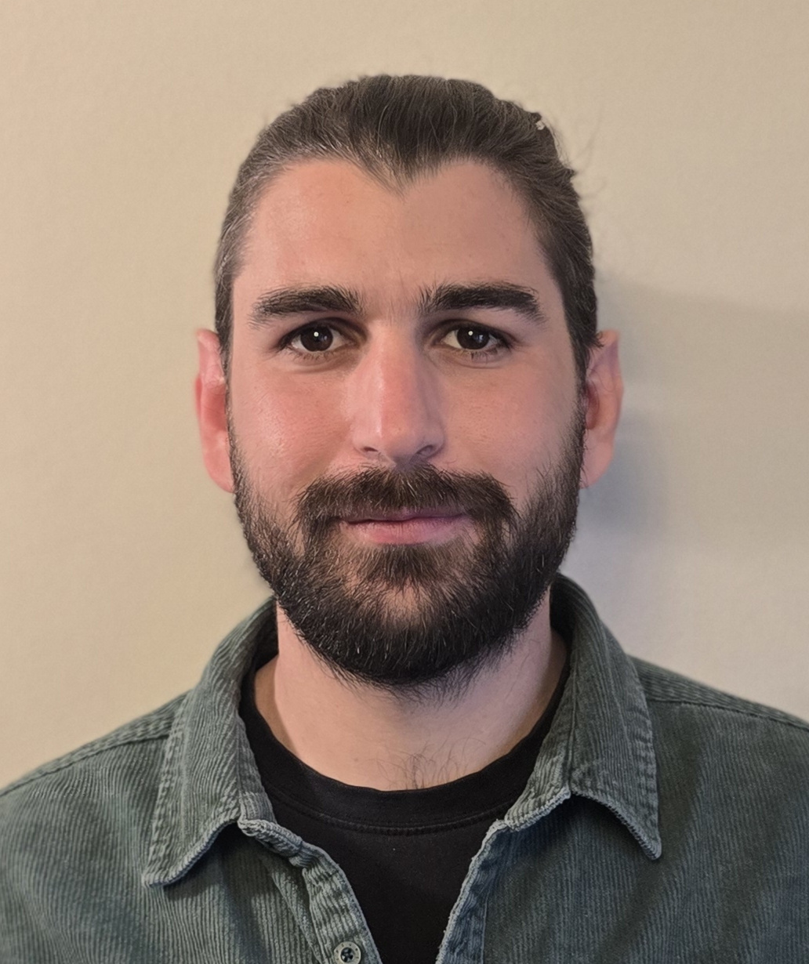
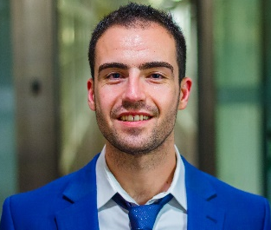
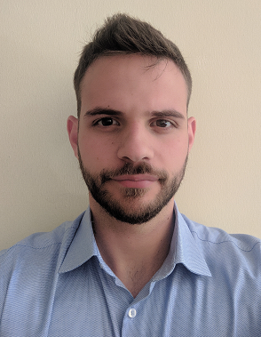
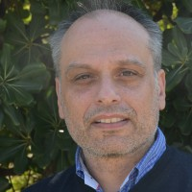
Contributors
Apostolos Prassas NSS TM + Soft. Engineer
Georgios P. Katsikas NSS Technical Leader
Kostis Trantzas ETSI OSL TSC Chair
Christos Tranoris ETSI OSL LG Chair

Slide 63



Acknowledgements
EU-funded Research and Development
HORIZON-JU-SNS-2022 ACROSS project with grant agreement number 101097122
Check our demo out!

Slide 64
Thank You! TFSsupport@etsi.org
Apostolos Prassas NSS TM Soft. Engineer
Georgios P. Katsikas NSS Technical Leader ETSI TFS TSC member ETSI OSL TSC member
gkatsikas at ubitech dot eu

